Slide 1


Customer Survey Analysis of Excel Boba Tea New Store
Welcome to the customer survey analysis of Excel's new Boba Tea shop! Let's explore the fascinating results of our survey and some valuable insights.
by Spaak Jobrigh NGOMA

Slide 2

OVERVIEW
1
Problem Statement
2
Goal
3
Tools
4
Insights
5
Build Dashboard

Slide 3

Problem statement
Excel Boba Tea is a real estate company that has recently launched its new store and would like to launch more stores, but is not sure which way to go. To address this issue, they decide to evaluate the experience of their Shop customer before launching a new one. As a data analyst, my job is to create a customer survey, collect data from customers and extract meaningful insights to help Excel Boba Tea understand customer needs and opinions about their new store.

Slide 4
Goal
My Goal is to create a relevant survey to collect information from customers, analyze dataset and create actionable metrics and visuals and design a user-friendly dashboard for Excel Boba Tea top-level management
KPI's REQUIREMENT
Total Send : Number of people they send the survey to
Total Response : number of people who respond to the survey
Response Rate: the percentage of responses
Average Rating : the average rating of product quality, variety, staff engagement, store environment
CSAT : Customer Satisfaction Score
NPS : Net Promoter Score

Slide 5


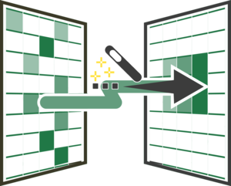

TOOLS FOR THE PROJET
1
Microsoft Forms for Data Collection
2
Power Query for Data Transformation
3
Pivot Table and Chart for Analysis, Report and Visualization

Slide 6
CUSTOMERS INFORMATIONS
Discovery Channels
Gender

Slide 7
CUSTOMERS INFORMATIONS
Boba Tea Customer Age Segmentation
Net Promoter Score(NPS)
16%
Detractor
37%
Passive
47%
Promotor

Slide 8
CUSTOMERS FEEDBACK
Customer Satisfaction(CSAT)
Average Rating of product & shop & Staff
59%
Good
41%
Bad

Slide 9
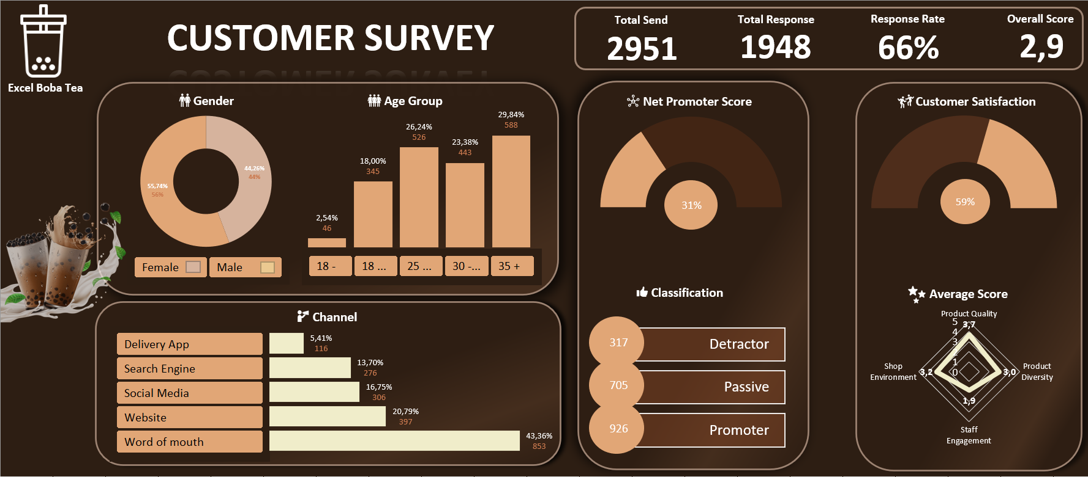
DASHBOARD DELIVERY TO THE MANAGER OF EXCEL BOBA TEA

Slide 10

Summary
Conclusion
Nous avons remarque que :

